Slide 1


OPS Lecture 1:
Microcontrollers
V1.1
Notes:
Changelist:
1.1:
Changed Slide 7 to provide a language Reference to arduino
Removed UCLA Specific content
Skipped certain slides that are potentially useful but not definitely.
1.0
Initial Release

Slide 2



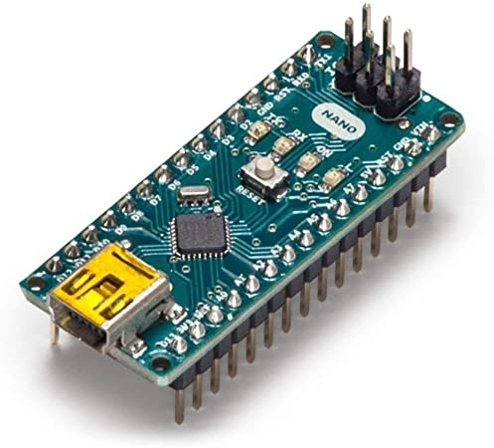
Welcome to OPS!!
Overview:
Lecture 1:
Arduino basics (microcontroller pinout, programming)
Lecture 2:
PWM (piezo speaker)
Lecture 3:
Transistors (IR emitter & receiver)
Lecture 4:
Serial communication (communication between arduinos)

Slide 3
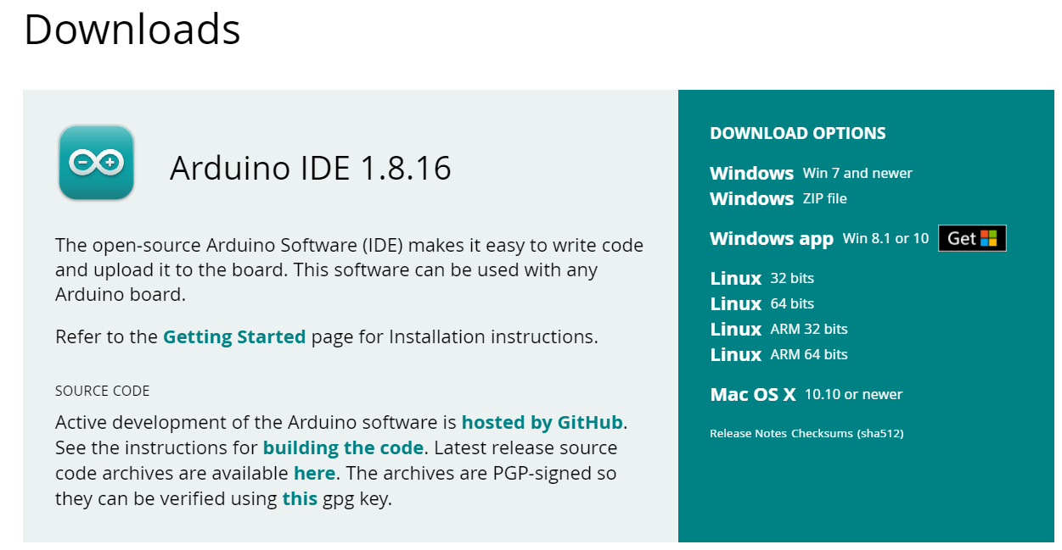
Downloading Arduino IDE
Link to download: https://www.arduino.cc/en/main/software
Click here for Windows
Click here for Mac

Slide 4
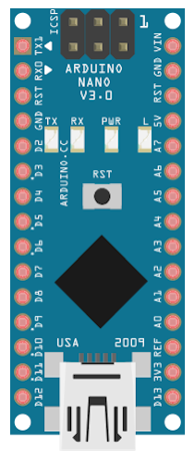
What is a Microcontroller? (MCU)
Arduino Nano
Essentially a small programmable computer that can coordinate different input/output functions in your circuit
ex: read temperature sensor and turn a fan motor accordingly, RC car, etc.
Connects to your circuit via different pins
Analog INPUT pins
Digital INPUT/OUTPUT pins
Digital PWM OUTPUT Pins (Analog OUTPUT)
Code (C++ in this case) controls hardware

Slide 5
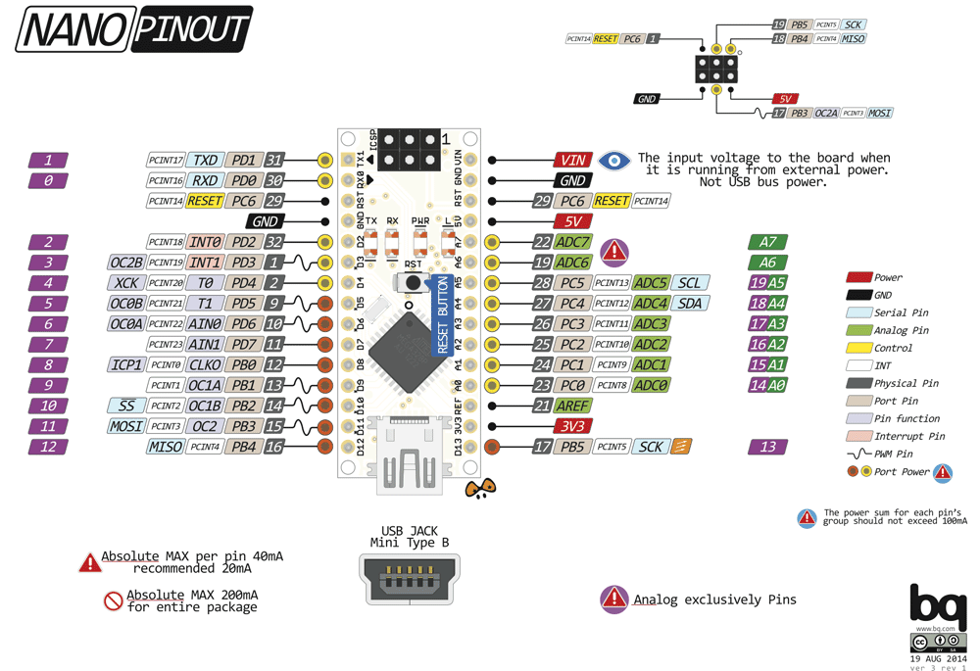
Arduino Nano pinout. It is basically a map of what each pin does. Consult it often!
Download it here: Google Drive link

Slide 6
For now, we’ll focus only on these pins:
The numbers/names in purple/dark green are recognized by the Arduino programming software. We will need this!

Slide 7
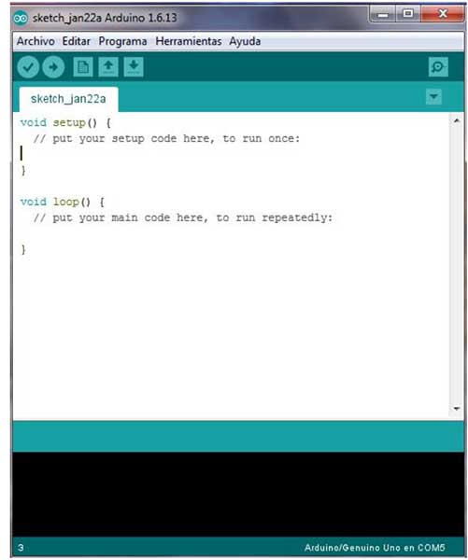
Programming your Arduino (C++)
The Arduino Integrated Development Environment (IDE) uses syntax that is very similar to C++
Variables, loops, functions, libraries, etc
Language Reference
New to programming? Please feel free to ask us for help!

Slide 8
C++ Syntax for Dummies
Calling Functions
Function Definition:
pinMode(pin#, INPUT/OUTPUT);
Call using:
pinMode(D4, INPUT);
Comments (don’t affect code)
// This is a comment
Semicolons after each statement
Declaring a variable
int x = 5;
Using a variable (case sensitive)
int y = x + 2;
int y = X + 2; ← Wrong!
If your syntax isn’t correct, the Arduino IDE will fail to compile and give you an error message!

Slide 9
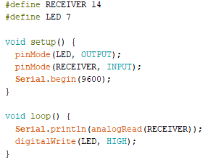
Arduino Code Structure
Define pins at the very top: Number: Purple number from pinout #define <variableName> <pin#>
setup():
Runs once at beginning
Initialize pin modes and global variables.
Set up rate for Serial (usually baud rate)
loop():
Runs repeatedly (infinite loop)
Core of your code. Implement what you want the microcontroller to do. (Ex. Printing to monitor: Serial.println(value);)

Slide 10
#define
Now, we can use “LED” to refer to the pin instead of looking up the pin# each time
#define <variableName> <pin#>
variableName can be anything
Check the number/name on the Arduino Nano pinout and replace <pin#> with it
If we ever change pins, we can just change our #define statement
Makes program organized & easier to manage

Slide 11
setup() functions
pinMode(pin#, INPUT/OUTPUT)
We #define’d our pins, so we can use the new name (RECEIVER/LED) instead of pin#
Specify if your pin is INPUT or OUTPUT.
Do this for ALL pins you use!!! Otherwise, your pin will do nothing!
Serial.begin(baud rate)
Allows us to use Serial.print()
The baud rate is rate for serial data transmission, usually for printing things out. We generally use 9600 bits per second.

Slide 12
loop()
The code in your loop() will repeat infinitely
The core of your code goes here
Program whatever it is you want your microcontroller to do
Usually, this will be reading inputs and outputting signals to various pins.

Slide 13
Basic Functions
Serial.print(text)
prints out text to the serial window
Serial.println(text)
same as above, but adds a new line afterward
Make sure you call Serial.begin(9600) in setup() or this won’t work!
digitalWrite(pin #, HIGH/LOW)
outputs discrete voltage (HIGH/LOW)
analogRead(pin #)
reads variable voltage
(a range from 0-1023)
delay(milliseconds)
pauses for a specified time

Slide 14
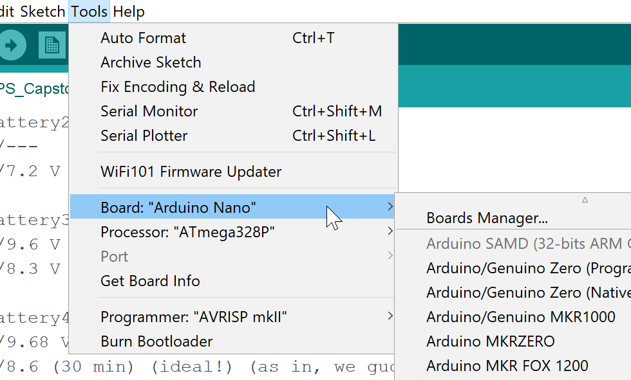
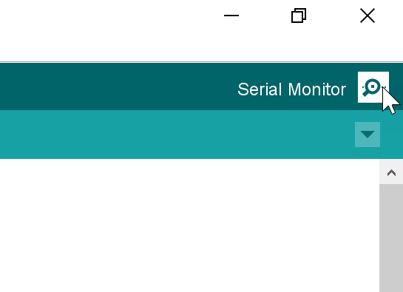
Printing to the Serial Monitor
Make sure the Arduino Nano board is selected under Tools
Select the proper COM port you are connecting the Arduino to under Tools
Upload your code
Open your serial monitor
Notes:
Include the port picture

Slide 15
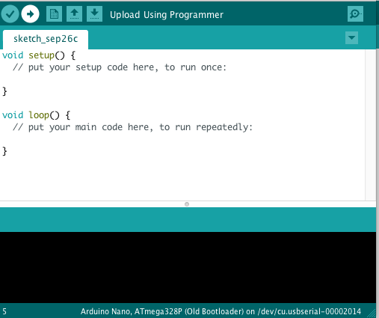

Uploading code to Arduino
Select correct serial port under Tools>Port
Click on the Upload button and you should see your Arduino flashing. The window should then display “Done Uploading.”
Code will not upload if:
It can’t be compiled/verified. Error messages will appear informing you about where in the code it went wrong
The wrong serial port is chosen

Slide 16
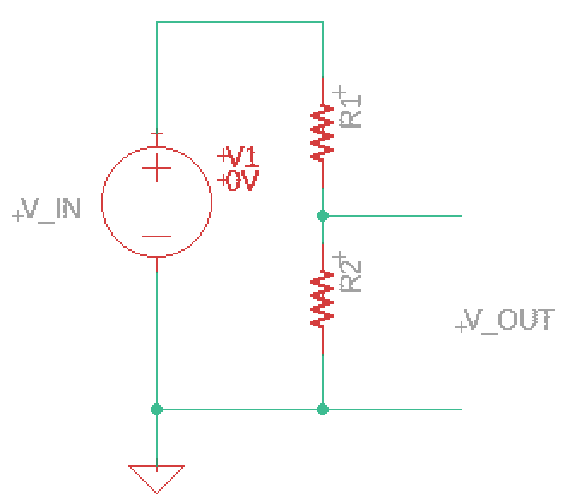
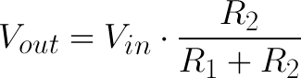
Example: Voltage Divider Circuit
When we connect an analog pin here and use analogRead(), we read a voltage given by the equation:
+5V
5V
Vout =?
**Since V=IR for each resistor, there is a larger voltage drop across the larger resistor value and a smaller drop across the smaller resistor. This “divides” the input voltage hence the name.
Vout will range between 0V-5V depending on R1 and R2
Vout in this case is voltage across R2
GND
Notes:
Jackie

Slide 17
Q: If Vin=5V, R1 = 10 Ohms, R2 = 10 Ohms, what is Vout?
A: Vout = 5 * [10/(10 + 10)]
= 5 * ½
Vout = 2.5V
+5V
5V
Vout =?
Each resistor has the same value so, the voltage across each should be split evenly
VR1 = 2.5V
VR2 = Vout =2.5V
GND

Slide 18
Q: If Vin=5V, R1 = 40 Ohms, R2 = 40 Ohms, what is Vout?
A: Vout is still 2.5V
+5V
The voltage is dependent on the ratio of R1 and R2, not the actual values of the resistors itself
Q: How does the current in circuit compare to the previous circuit? Is it higher or lower? How can we find the value?
A: Resistors add in series, so Req = R1 + R2 and since V= IReq → I = V/Req
5V
Vout =?
GND

Slide 19
Q: If Vin=5V, R1 = 30 Ohms, R2 = 10 Ohms, what is Vout?
A: Vout = 5 * [10/(10 + 30)]
= 5 * ¼
Vout = 1.25V = VR2
VR1 = 5 - 1.25V = 3.75V
+5V
5V
Vout =?
Rule of Thumb
R1 > R2, VR1 > (VR2 = Vout)
R1 < R2, VR1 < (VR2 = Vout)
GND

Slide 20
Q: If Vin=5V, R2 = 30 Ohms, Vout=2.5V, what is R1?
A: 2.5V = 5V * 30/(30+R1)
→ R1 = 30
+5V
5V
Vout =?
GND

Slide 21
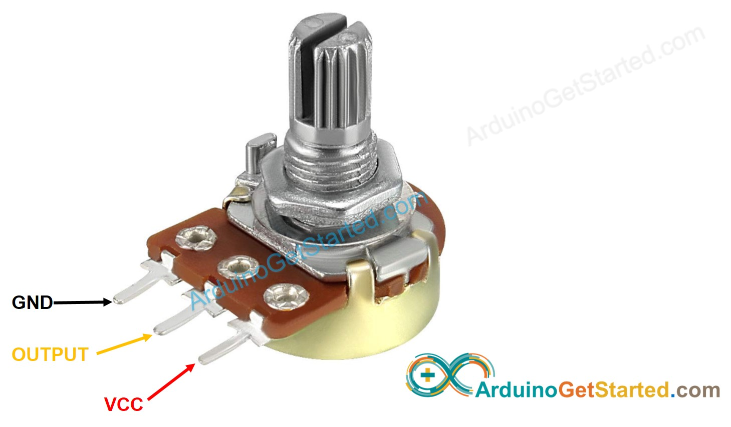
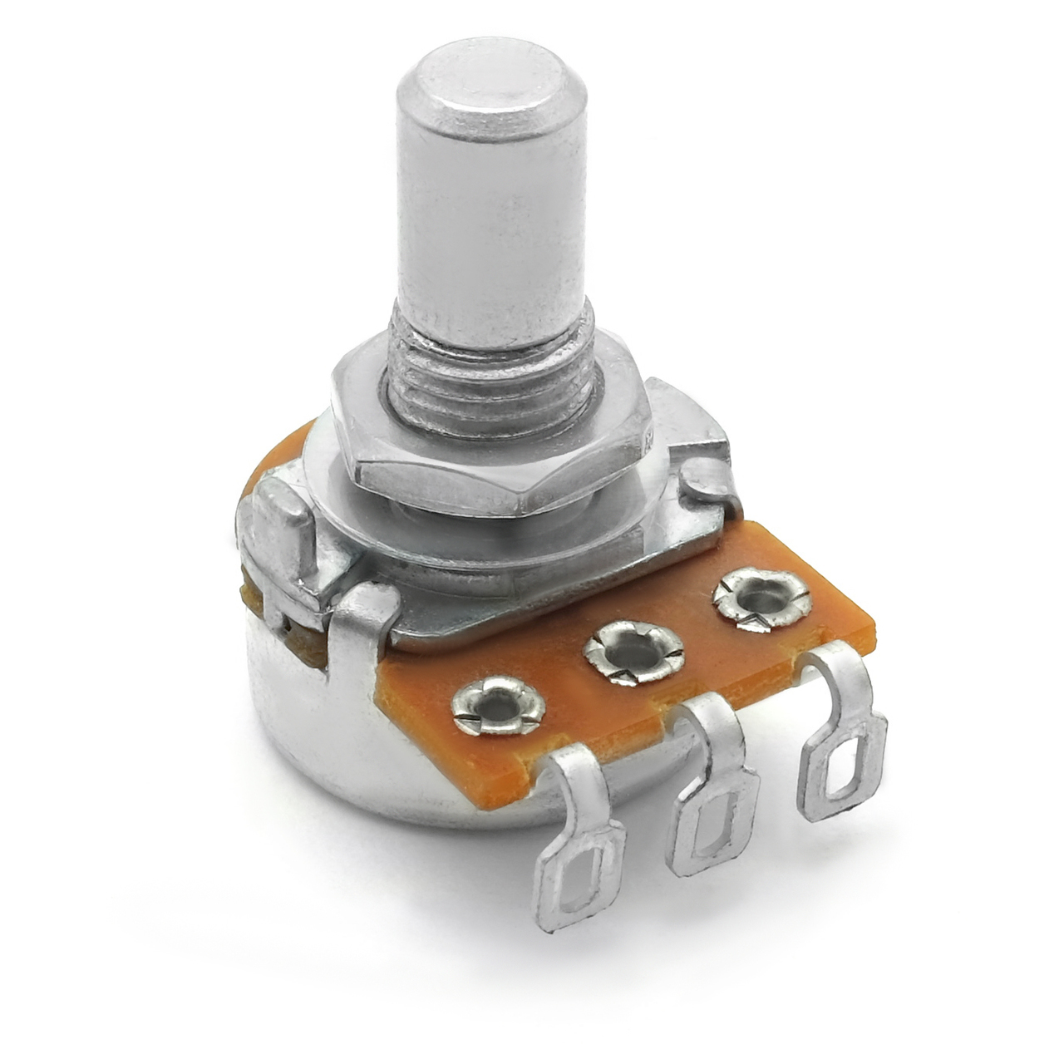
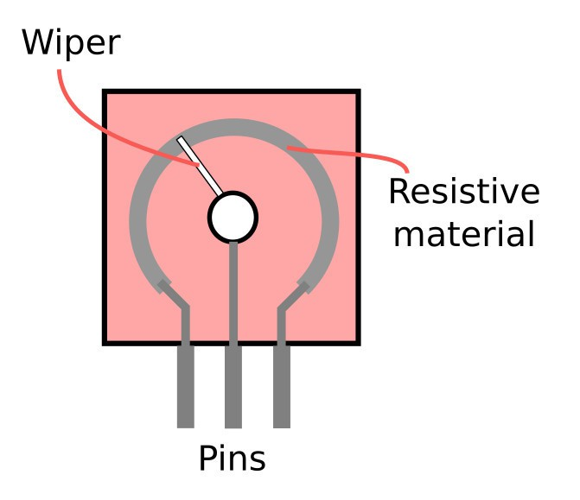
Potentiometer
A potentiometer can act as a variable voltage divider:
Connect the potentiometer pins to the arduino’s respective pins
The middle potentiometer pin connects to an analog pin
We can now use analogRead() to detect the voltage of the wiper, which can be varied from ~0-5V by turning the knob to move the wiper.

Slide 22
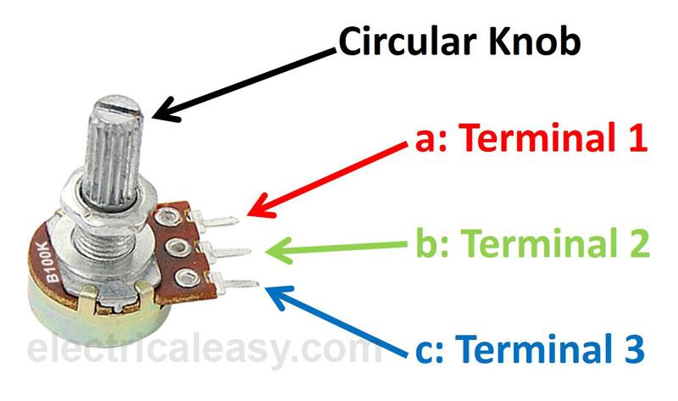
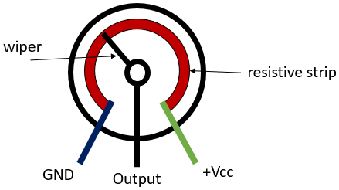
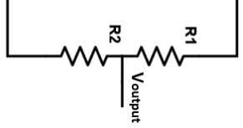
Potentiometer
We have an R =100 KOhm potentiometer
Can move the wiper with the knob and effectively change the resistances R1 and R2
R = R1 + R2 = 100K Ohms
R1 and R2 are complementary, meaning they add up to 100K Ohms
If R1 = 10 KOhms, then R2 = 90 KOhms

Slide 23
Potentiometer as a Voltage Divider
Side pin 1 (+5V)
R1
R2
5V
+5V
GND
Wiper (Analog Pin). By turning the knob, the values of R1 and R2 change. This, in turn, changes the read voltage.
Side pin 2 (GND)
Arduino
Notes:
Bryan

Slide 24

Break - Questions?
Review:
Arduino pins and pinout
Arduino IDE and programming
Potentiometer as a variable voltage divider

Slide 25
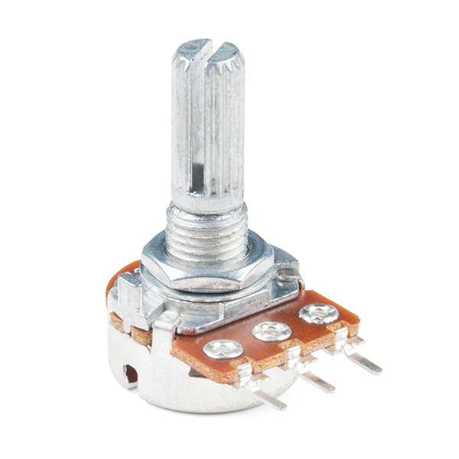

Project 1: Potentiometer Blink

Slide 26
Project 1: Potentiometer Blink
Create a blinking LED with its blinking rate controlled by a potentiometer
Print the value being read from the potentiometer to your Serial monitor
Project isn’t too complicated, it’s just for you to get a first look at how to use a microcontroller.

Slide 27
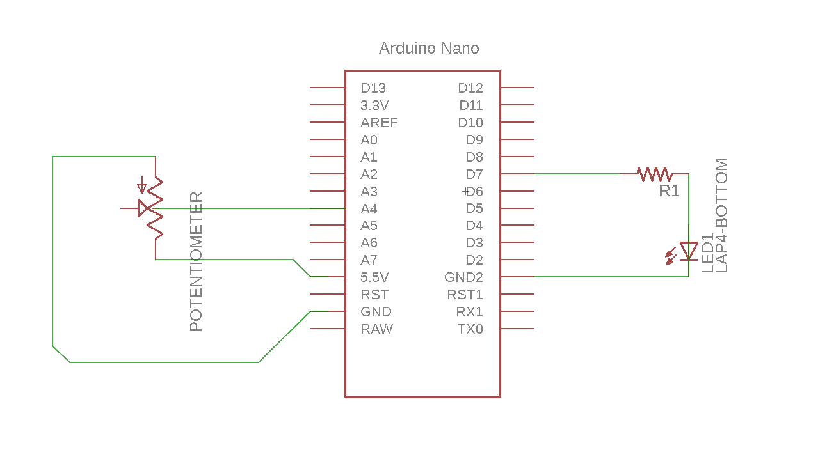
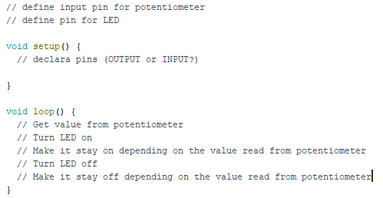
Schematic and Pseudocode
5V
Pseudocode: text that describes what the actual code does, concisely explaining it for readers

Slide 28
The LED Circuit
digitalWrite(LED_PIN, HIGH); //5V LED on
digitalWrite(LED_PIN, LOW); //0V LED off
To power the LED circuit, we will use D7 as an OUTPUT pin
#define LED_PIN 7 //D7 is 7
pinMode(LED_PIN, OUTPUT);
digitalWrite(LED_PIN,HIGH);
Could also use any one of D0-D12 or A0-A5 pins
D7 acts as a voltage source (5V) for the circuit if it is HIGH
Notes:
skip

Slide 29
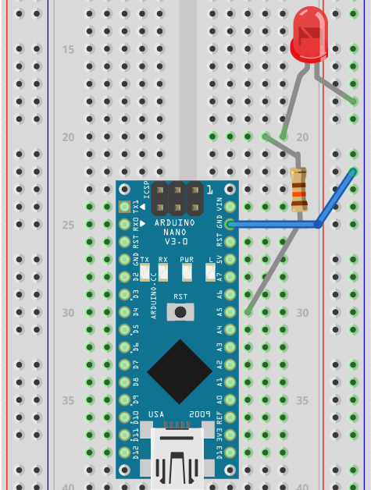
*Just an example board, not what’s described
+
-
Create the LED Circuit
Place Arduino in the bridge of the breadboard
First connect your Arduino to your computer through the micro USB cable
Connect the ground pin to the ground line
Connect one end of the resistor to pin D7 and the other end to an unused part of the breadboard
Connect the longer leg (anode +) of the LED to the end of the resistor that IS NOT connected to pin D7
Connect the shorter leg (cathode -) of the LED to the ground line

Slide 30
Program the Arduino
to make the LED blink
Reminders for programming:
To define a pin
#define <pin_name> <pin number>
To set baud rate
Serial.begin(9600);
To set the pinmode to output or input
pinMode(<pin_name>,OUTPUT or INPUT);
To turn LED on, provide the “voltage source”
digitalWrite(<pin_name>,HIGH);
To delay code and keep LED on for a certain amount of time
delay(<time in ms>);
To turn LED off, take away source (0V)
digitalWrite(<pin_name>,LOW);
To read value from Potentiometer
analogRead(<pin_name>);
**Just replace the brackets < > with the corresponding value!
Notes:
Add analogRead() to right column

Slide 31
Common Mistakes
Shorting 5V and GND by connecting adjacent pins of potentiometer and turning knob so that the resistance between the 2 pins is 0
Copying the #define RECEIVER 14 into your Arduino program exactly… it is only an example!

Slide 32


Project Deadlines
Potentiometer blink is due:
Monday Students: 10/4
Thursday Students: 10/7
More project details here
Come to our LAB HOURS for help!
Check out lab hours for:
(Mon): Ryuichi, Rachel, or
(Thur): Wesley, Paula

Slide 33

Thank You!

Slide 34
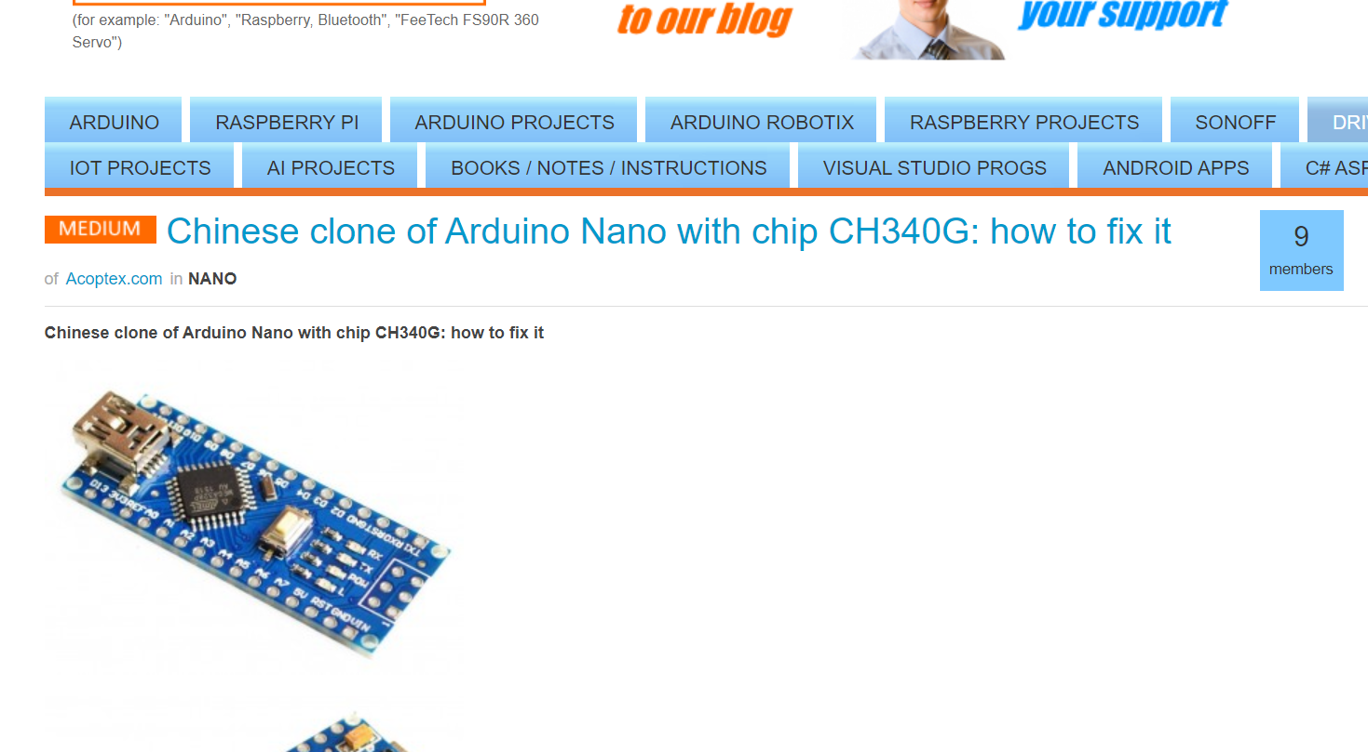
Driver problems
Sometimes if you can’t upload code to the Arduino, you may need to download driver for the Arduino Nano:
Link here to download
^ Link here

